Slide 1

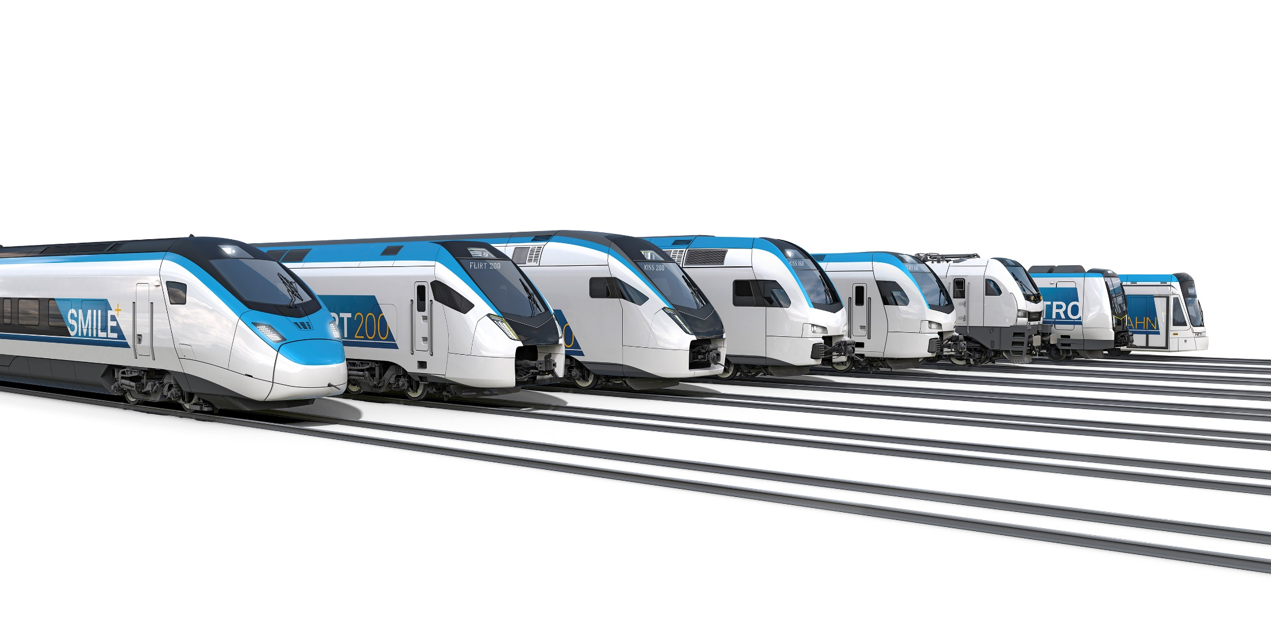
Individuality in Rail Transport
Friends of the Far North Line
James McCaffery, Helmsdale, 23.06.2023

Slide 2
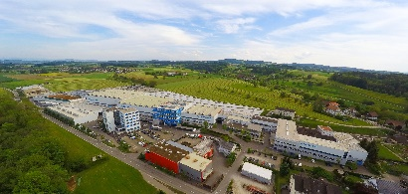
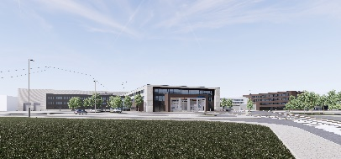
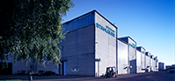
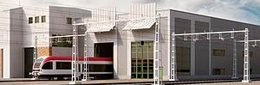
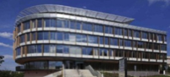
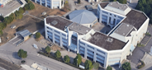
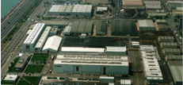
Divisions 2023
STADLER RAIL GROUP
Switzerland
Germany
Components
Service
  Bussnang, CH
  St. Margrethen, CH
  Altenrhein, CH
  Salt Lake City, USA
  Berlin, DE
  Mannheim, DE
  Chemnitz, DE
  Winterthur, CH
  Biel, CH
  Szolnok, HUN
  Środa, PL
Algeria
Denmark
Germany
Finland
France
Georgia
Italy
Netherlands
Norway
Austria
Poland
Portugal
Russia
Serbia
Sweden
Switzerland
Spain
Turkey
UK
Hungary
USA
Belarus
Central Europe
Signalling
Spain
  Siedlce, PL
  Prag, CZE
  Minsk, BLR
  Wallisellen, CH
  Fehraltorf, CH
  Vufflens-la-Ville, CH
  Braunschweig, DE
  Valencia, ES
  ERION, ES
  ERION, F
Consolidated turnover in 2021: CHF 3.6 billion | Number of employees (average FTE 2021): 13 067

Slide 3
Turnover Development
STADLER RAIL GROUP

Slide 4
Workforce growth
Stadler Rail Group

Slide 5
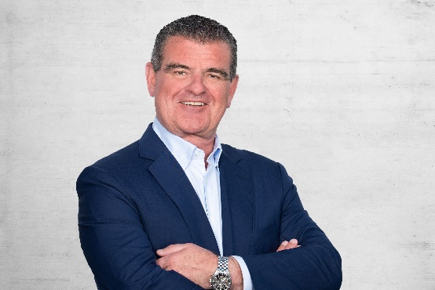
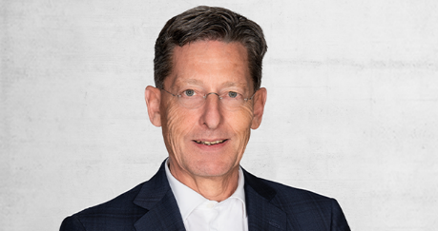
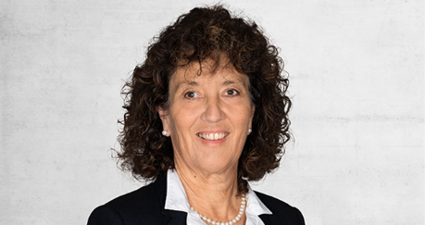
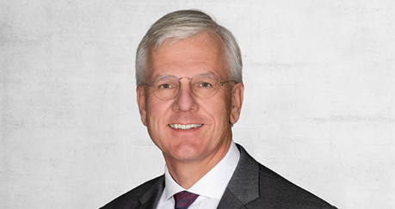
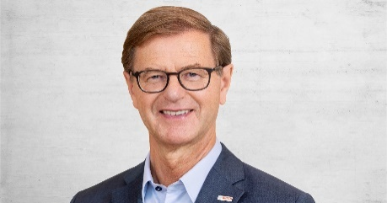
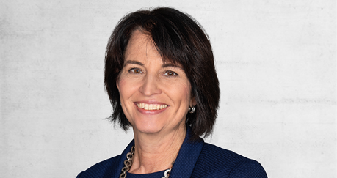
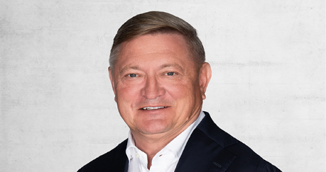
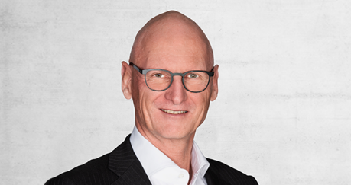
Board of directors
Members
Peter Spuhler
President of the Board of Directors
Hans-Peter Schwald
Vice President of the Board of Directors, Managing Partner of BIANCHISCHWALD LLC
Barbara Egger-Jenzer
Lawyer, former Government Council member
Dr Christoph Franz
President of the Board of Directors of Roche, former CEO of Lufthansa
Prof. Dr. Stefan Asenkerschbaumer
Chairman of the supervisory board of Robert Bosch GmbH
Doris Leuthard
Lawyer, former Federal Councillor and Former Head of DETEC
Wojciech Kostrzewa
President and CEO of Billon Group Ltd.
Kurt Rüegg
Co-owner of Alantra AG

Slide 6
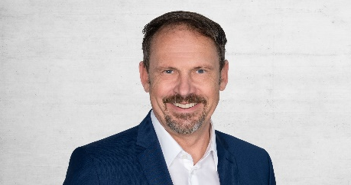
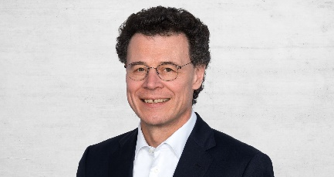
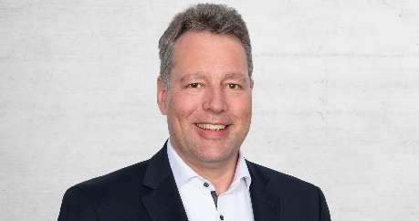
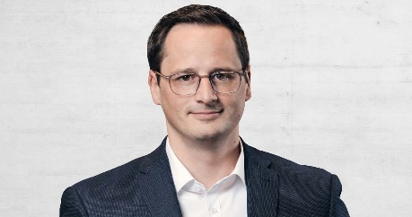
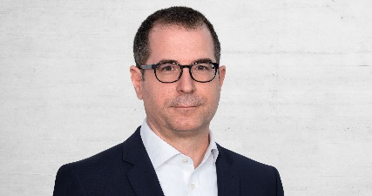
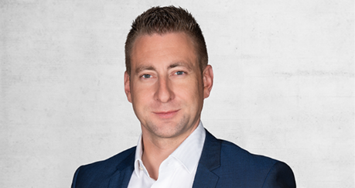
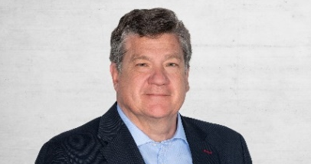
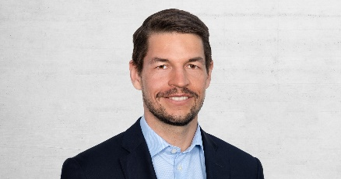
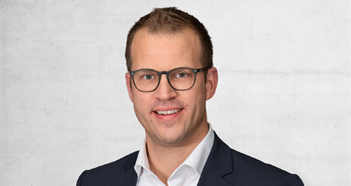
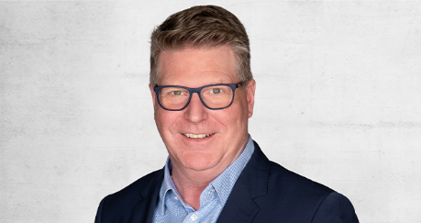
GROUP EXECUTIVE BOARD
Members
Markus Bernsteiner
Group CEO
Raphael Widmer
Group CFO
Dr. Ansgar Brockmeyer
Executive Vice President Sales & Marketing, Deputy Group CEO
Lucius Gerig
Executive Vice President Switzerland
Jure Mikolčić
Executive Vice President Germany
Philipp Brunner
Executive Vice President Central Europe
Iñigo Parra
Executive Vice President Spain
Marc Trippel
Head of Division Signalling
Daniel Baer
Executive Vice President Service
Christian Spichiger
Executive Vice President Components

Slide 7
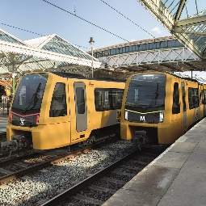
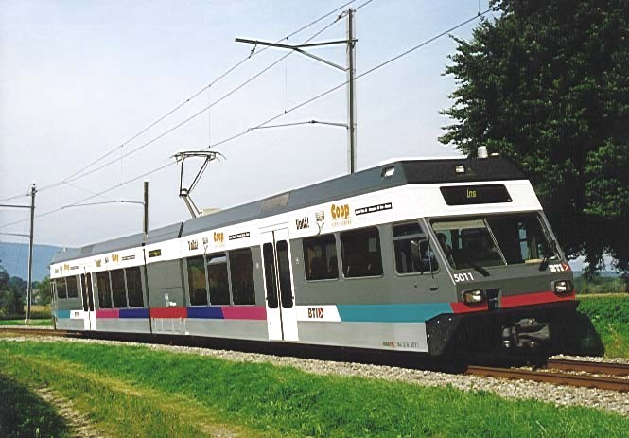
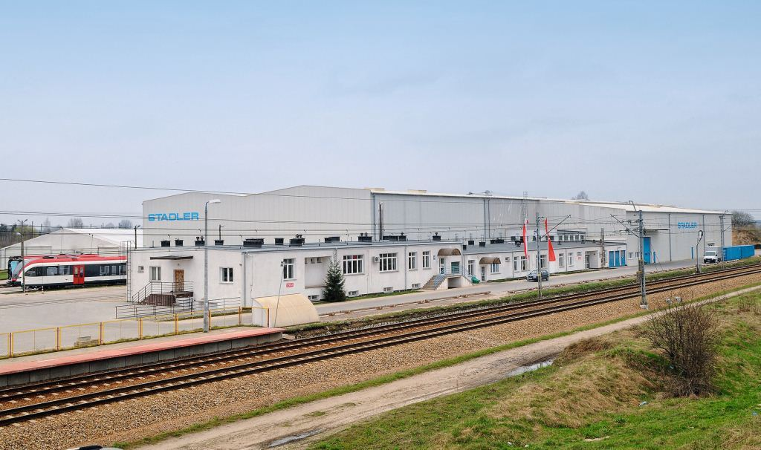
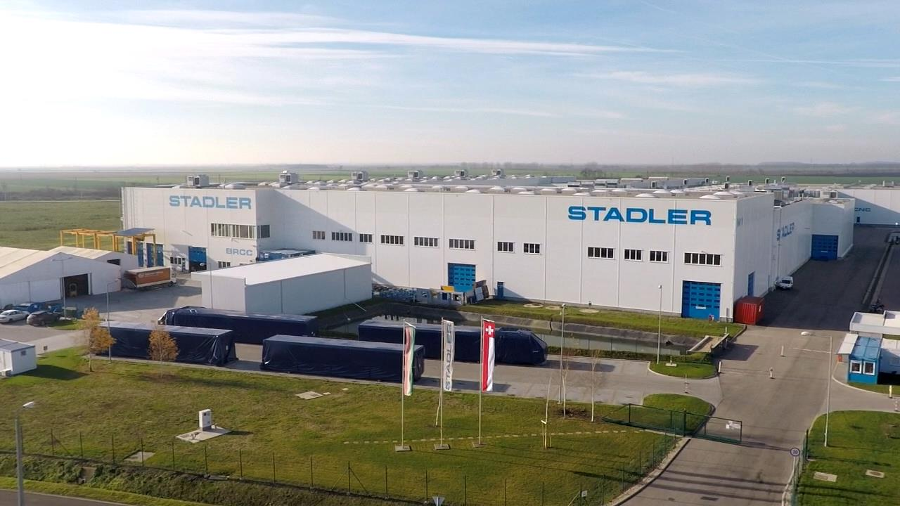
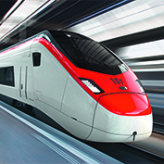
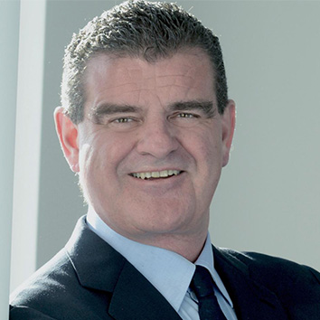
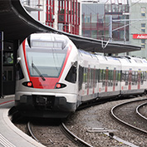
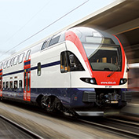
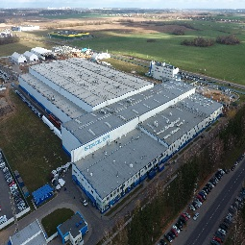
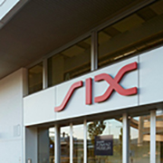
A SOLID BASIS FOR THE FUTURE
STADLER RAIL GROUP
Stadler secures another large order in the UK: 42 METRO trains for Tyne and Wear Metro, including a 35-year maintenance contract.
Ernst Stadler opens an engineering office in Zurich.
Stadler Szolnok Vasúti Járműgyártó Kft. and Stadler Praha s.r.o. are founded.
The first GTW 2/6 is introduced.
Taking only 23 months to build, the SMILE is presented at InnoTrans.
Stadler Polska Sp. z o.o. is launched.
1942
TO
2021
1942
1995
2006
2009
2016
2020
1989
2004
2008
2012
2019
Peter Spuhler takes over
Stadler Fahrzeuge AG and its 18 employees.
The first FLIRT for SBB goes into operation.
Stadler receives the first order from SBB for KISS double-decker trains.
Stadler invests in Belarus and founds CJSC Stadler Minsk.
Stadler goes public. On 12 April, the shares of Stadler Rail AG are listed on the SIX Swiss Exchange.

Slide 8


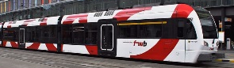









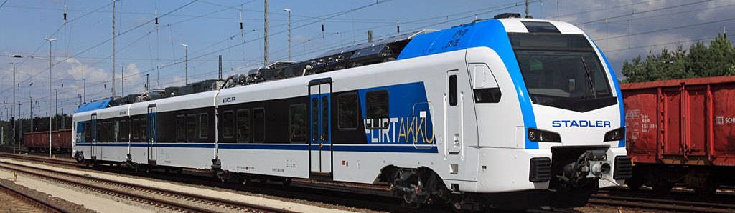
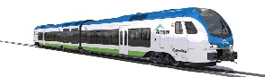


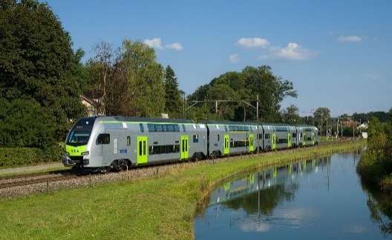

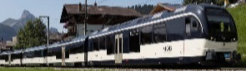






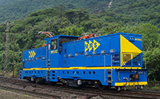






Rolling Stock Market segments
SEGMENTATION
MODULAR CONCEPTS
Adhesion drive
TAILOR-MADE VEHICLE CONCEPTS
Adhesion drive and rack-and-pinion drive
URBAN TRANSPORT
LRV
Tram
≤80 km/h
Tram Trains
≤100 km/h
Metro
Metro
≤100 km/h
HEAVY RAIL
DMU/ BMU
Regional rail/ suburban rail
≤160 km/h
XMU
Regional rail/ suburban rail
≤160 km/h
EMU
Regional rail/ suburban rail
≤160 km/h
Intercity trains
≤200 km/h
Not a priority
Highspeed
≤250 km/h
Very Highspeed
>250 km/h
Not a priority
Loco-motives
Main-line locomotives
Diesel/dual-power/electric
Shunting locomotives/
special vehicles
Carriage
Passenger and sleeper carriages
Freight wagons
Not a priority
Not a priority

Slide 9


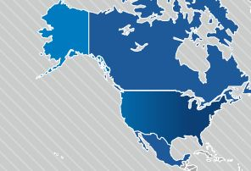
8 production locations and 7 component LOCATIONS
BELARUS
Germany
POLAND
CZECH REPUBLIC
SWITZERLAND
HUNGARY
SPAIN
USA

Slide 10
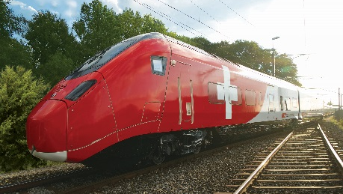
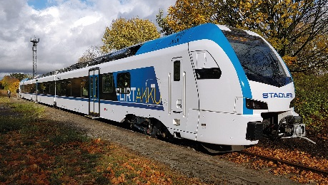
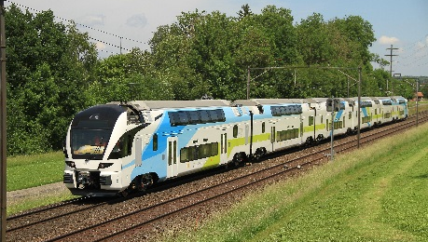
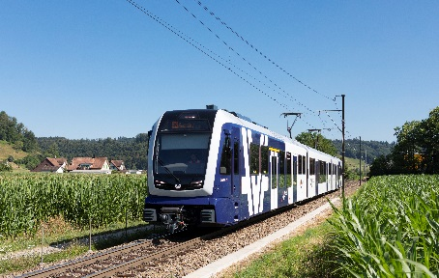
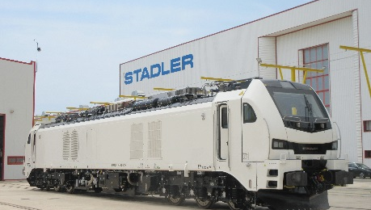
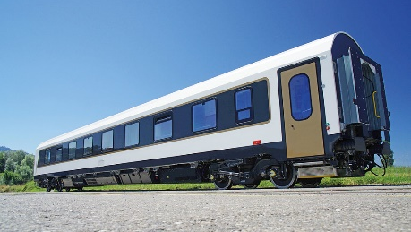
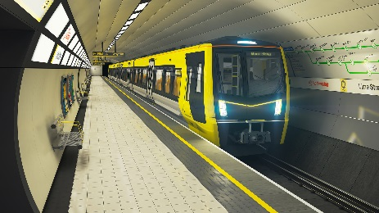



More than 10883 vehicles sold
In 43 countries
36
2465
585
1049
SMILE
FLIRT / WINK
KISS
Tailor-made (multiple units / locomotives / carriages)
2488
155
824
1941
Locomotives
Carriage
METRO
LRV
497
532
Regional rail shuttle
GTW (articulated multiple units)

Slide 11

Stadler’s presence in the UK
Currently 400+ employees in the country, numbers to increase
Programme Lead | James McCaffery | © Stadler | 23.06.2023

Slide 12







Stadler’s Current UK Portfolio
Most contracts with service agreement
Greater Anglia, Abellio: 20 EMU / 35 BMU FLIRT
Wales, Keolis/Amey, 36 Citylink / 35 FLIRT
DRS/Beacon Rail: 34 / 10 UK Light Class 68 / 88
ROG: 10 UK Light Class 93
Newcastle, NEXUS, 42 Metro units
Merseytravel: 53 Metro units (7 IPEMU)
Glasgow: 17 ATO Metro units
Sheffield Supertram: 7 Citylink Class 399
London Tramlink Croydon: 12 Variobahn trams
A wide range of products and services in the UK
Programme Lead | James McCaffery | © Stadler | 23.06.2023
12

Slide 13


Glasgow Subway
Inside bigger than outside
Programme Lead | James McCaffery | © Stadler | 23.06.2023

Slide 14


Glasgow Subway
Inside bigger than outside
Programme Lead | James McCaffery | © Stadler | 23.06.2023

Slide 15

MERSEYTRAVEL ROLLING STOCK Solution
Liverpool Central Station
Programme Lead | James McCaffery | © Stadler | 23.06.2023

Slide 16
MERSEYTRAVEL ROLLING STOCK
Articulated concept vs legacy fleet
Lightweight Vehicle: Articulated Layout
Unit Length: 60.7 m -> 64.98 m
Number of Bogies: 6 -> 5
Tare Weight: 104.5 t -> 98.4 t
TB
MB
MB
MB
TB
Reduced Unit Weight
Reduced Maintenance Cost
Programme Lead | James McCaffery | © Stadler | 23.06.2023

Slide 17

MERSEYTRAVEL ROLLING STOCK
door safety features
Platform train interface and Safe dispatch of the train
at the platform
1. Automated and live warning
2. CCTV cameras
3. Visible assistance system (colour will be defined)
4. Gap closers
5. Intelligent sliding steps
Addressing the safety issues for the passengers
Programme Lead | James McCaffery | © Stadler | 23.06.2023

Slide 18

ENGINEERING SOLUTIONS FOR YOUR TRANSPORT PROBLEMS
2035 Decarbonisation
Mixed Infrastructure
Bridging the gap
Novel solutions required
Scotland’s Unique Position
Programme Lead | James McCaffery | © Stadler | 23.06.2023

Slide 19

Flirt^{UK}
The Regional Train concept for the UK
Stadler’s Multi Talent
Programme Lead | James McCaffery | © Stadler | 23.06.2023

Slide 20
Flirt^{UK}
Modular Concept
EMU 12-car
BMU 4-car (3rd Rail, 25kVAC or pure DMU)
BMU 3-car (3rd Rail, 25kVAC or pure DMU)
Motor bogie Power Pack Articulated design Low floor Entrance
Two different car length
One Power Pack for all DMU and BMU (number of Diesel engines may vary)
Same Trailer-, Motor-, and Jacobs bogie for all units.
Same entrance level for all units
Programme Lead | James McCaffery | © Stadler | 23.06.2023
Notes:
Gap closers erwähnen

Slide 21
Flirt^{UK}
Power Pack East Anglia
Power Packed together
Power distributed
throughout the unit
Power distributed
troughout the unit
2 Power compartments
on each side
1 x 2300 l fuel tank
Power Pack with either:
- 4 Diesel engines
- 2 Diesel engines
- A combination of Diesel engines and Batteries
Notes:
Gap closers erwähnen

Slide 22

Overview FLIRT^{UK}
FLIRT^{UK} POWER PACK

Slide 23


Flirt^{UK}
Low floor design
Easy access for everyone
Low floor solution with level entrances allows autonomous
access for PRM
Safe and fast access to the unit → reduces station dwell times and improves passenger flow.
Retractable sliding step reduces gap to the platform → safer access to unit
Low floor design
Programme Lead | James McCaffery | © Stadler | 23.06.2023
Notes:
Gap closers erwähnen

Slide 24











Zero Emission
Battery Technology at the heart of Stadler’s DNA
Battery Tractors
Schumacher & Co.
Switzerland
Tram-Train with battery support,
SANTOS , Brazil
FLIRT AKKU, Prototype
Germany
H2 FLIRT
SBCTA, California USA
Milage Record
224 km
Battery Shunting Locomotive for SBB, CH
1943
1987
2012
2017
2019
2021
1943
TO
2021
1946
2008
2017
2018
2019
Battery Tractors
Berner Oberland Bahnen
Switzerland
Stadtwerke München,
Germany. Guiness-Worldrecord-18.98km on batteries.
WINK BMU / WINK ZERO EMISSION,
The Netherlands
Tri-Mode FLIRT UK,
Wales and Borders
Battery FLIRT for Schleswig Holstein, Germany

Slide 25

flirt^{AKKU}
Stadler Battery Train Family

Slide 26





Stadler battery projects
Flirt
Elron, Estonia
20 diesel trains with “Supercaps” Location of batteries: Roof
Concept: Booster function and reduction of diesel consumption
Revenue Service: 2014
ARRIVA, the Netherlands
18 electric / diesel trains
Location of batteries: Roof
Concept: Use batteries for support and reduce emissions
Revenue Service: 2021
FNM, Milano, Italy
30 diesel / battery trains
Location of batteries: PowerPack
Concept: Drive with diesel and use batteries for acceleration
Revenue Service: 2022
SBCTA, CA, USA
H2 / battery train
Location of batteries: PowerPack
Concept: Combined system – battery for peaks (acceleration)
Revenue Service: 2024
Keolis, Wales & Borders, UK
24 EMU3+EMU4 / battery + diesel
Location of batteries: PowerPack
Concept: Drive electric and with battery/diesel combined (flexible)
Revenue Service: 2023
Programme Lead | James McCaffery | © Stadler | 23.06.2023

Slide 27

FLIRT AKKU
Product overview
Drives (current converter
+ electric traction motor)
High-voltage equipment (pantograph,
circuit-breaker and transformer or line filter)
Batteries

Slide 28



FLIRT BMU (Diesel)
Powerpack – Flexible design
Up to 4 diesel engines with a total of 1’920 kW can be installed.
Up to 1’800 kWh of Batteries can be installed.

Slide 29

FLIRT ^{H2} Power Pack
General overview
Cooling system
Hydrogen tank modules
storage @ 350 bar
Free passenger
passway
Fuel cell compartment
DC / DC converters
and cooling unit
All hydrogen related components are placed in the power pack. The amount of hydrogen energy ranges from 2.5 to 5.1 MWh usable energy.

Slide 30






Stadler other battery projects
Metro, LRV, Locomotives
Rhaetian Railway, GEAF 2/2
7 Bi-mode shunter locomotives
Location of batteries: Carbody
Concept: Battery for construction and shunting operations
Revenue Service: 2020
Mersey Rail, Liverpool, UK
53 electric metro-trains & battery
Location of batteries: Floor
7 units ordered to reach outer destinations with battery Revenue Service. Order in 2022
Wales & Borders, Cardiff, UK
36 electric / battery tram-trains
Location of batteries: Floor
Concept: Drive with battery on not electrified sections
Revenue Service: 2022
Nexus, Tyne & Wear, UK
42 electric metro-trains & battery
Location of batteries: Floor
Concept: Shunting and emergency operations with battery
Revenue Service: 2023
Rail Operations, Class 93, UK
10 (+20) tri-mode locomotives
Location of batteries: Carbody
Concept: Combined system – battery & diesel for last mile
Revenue Service: 2024
Rescue Trains, OEBB
5 (+15) electric / battery + diesel
Location of batteries: Distributed
Concept: Rescue / Maintenance on electr. railways without supply
Revenue Service: 2024
Programme Lead | James McCaffery | © Stadler | 23.06.2023

Slide 31






Stadler Rail service - uk
Close Collaboration
We are partners to our customers
Local on-site support
Decentral service delivery
People Business
Our employees are our main asset
Partner Network
Group of selected partners
Clever Solutions
Innovative solutions in close collaboration with vehicle engineering
Notes:
SRS Values

Slide 32

STADLER DEPOT CONSTRUCTION - newcastle

Slide 33


Thank you
for your attention

